Slide 1
ID CARD GENERATOR
PROJECT PRESENTATION
Prepared By:
Mohammad Basil Ali Khan (20K -0477)
Abdul Ahad Shaikh (20K- 0319)
Syed Jodat Ali Naqvi (20K-0155)

Slide 2
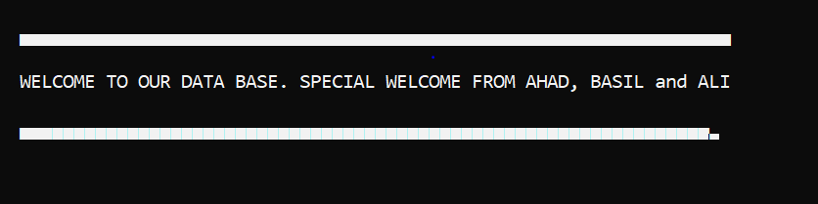
WELCOME SIGN

Slide 3
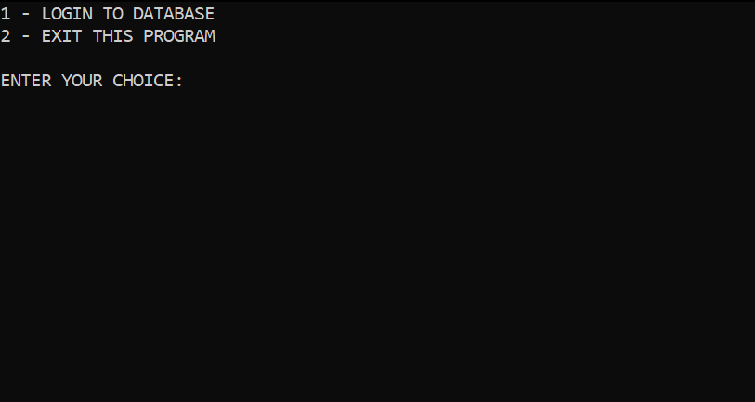
INITIAL SCREEN
At first, the user has 2 options. Whether to exit the program or login to the data base. For now, we’ll choose to login and explain further.

Slide 4
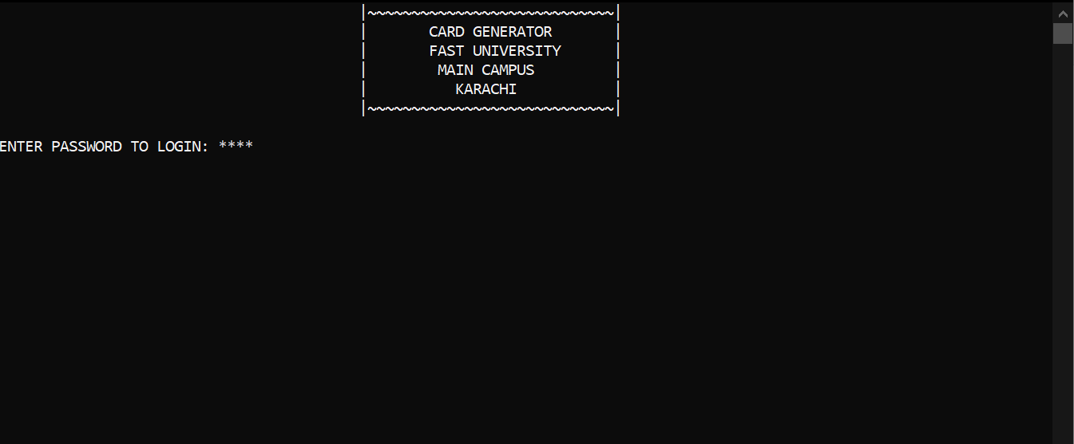
LOGIN PAGE

Slide 5
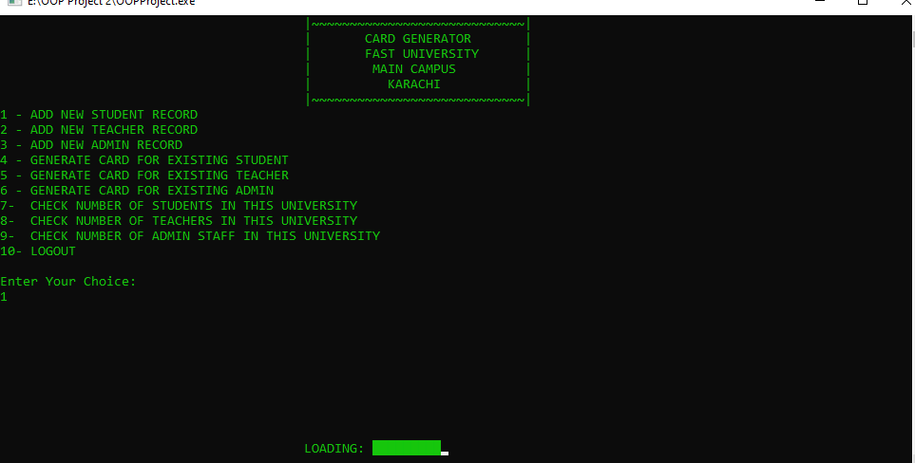
MAIN MENU PAGE

Slide 6
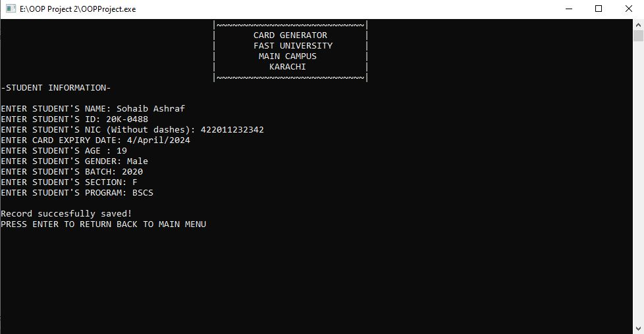
STORING NEW STUDENT RECORD

Slide 7
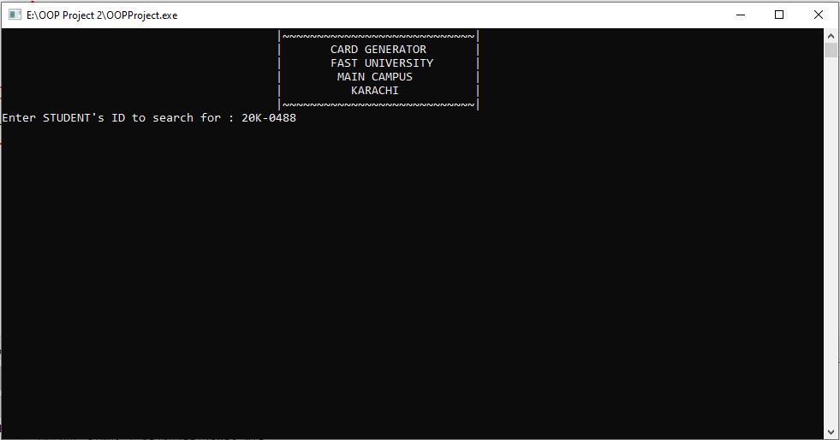
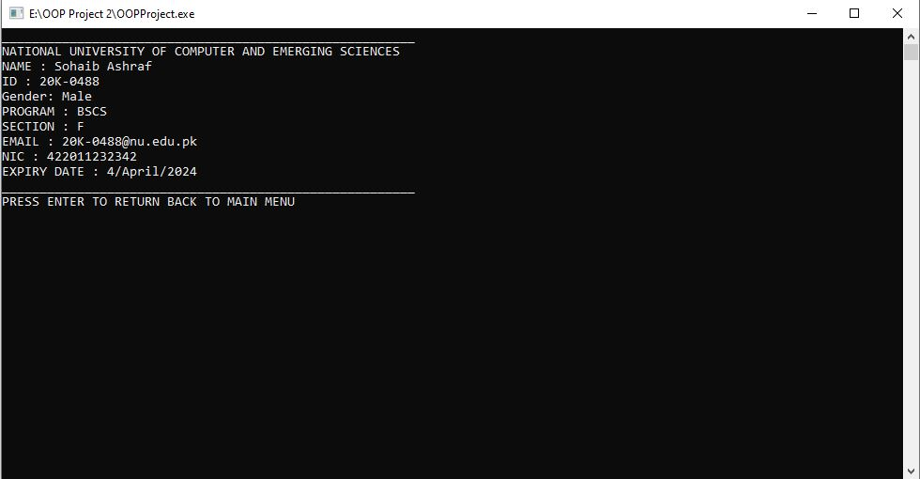
SEARCHING STUDENT DATA AND GENERATING CARD

Slide 8
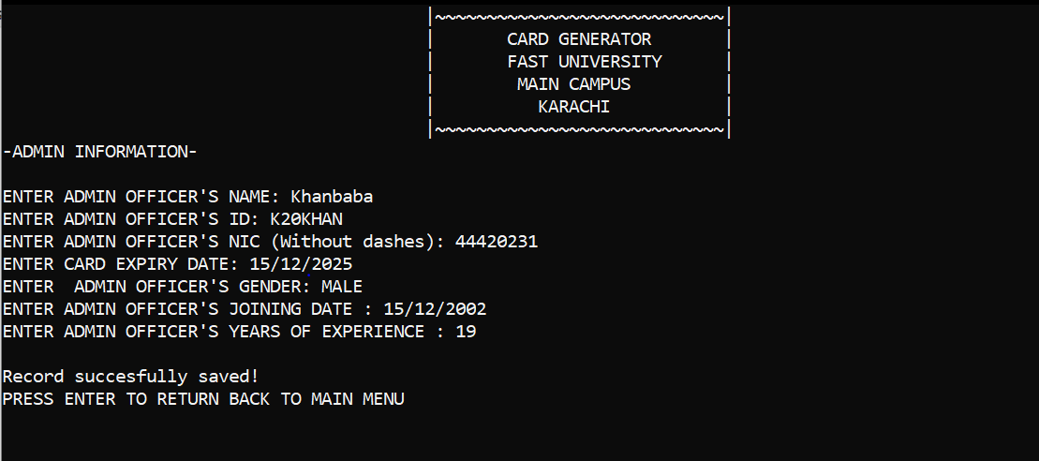
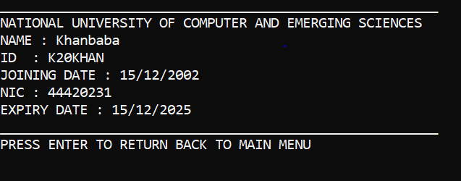
SEARCHING ADMIN DATA AND GENERATING CARD

Slide 9
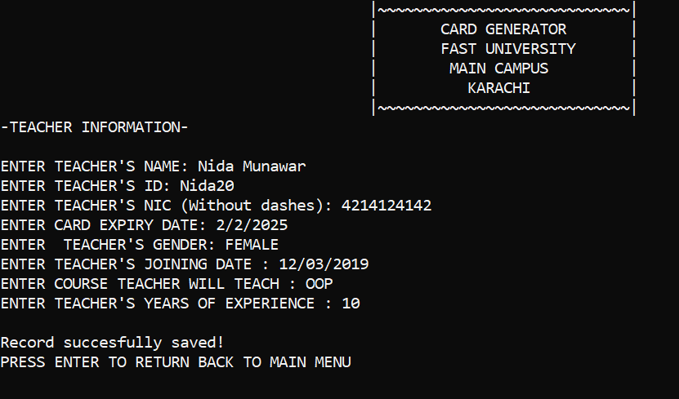
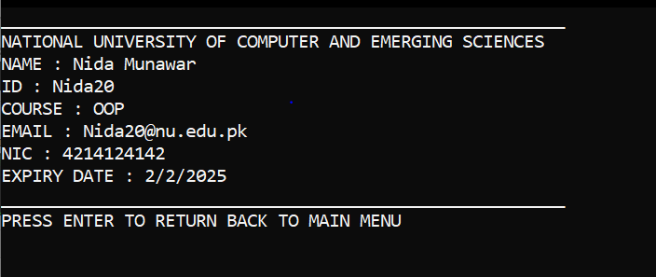
SEARCHING TEACHER DATA AND GENERATING CARD

Slide 10
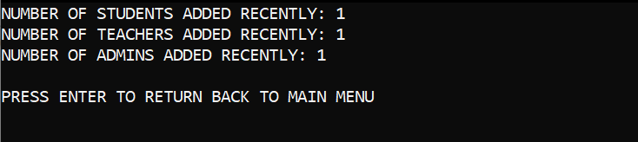
CHECKING NUMBER OF CHANGES DONE IN THE PROGRAM BY USER

Slide 11


